Slide 1
Configuration Management

Slide 2
Topics covered
Change management
Version management

Slide 3
Configuration management
Because software changes frequently, systems, can be thought of as a set of versions, each of which has to be maintained and managed.
Versions implement proposals for change, corrections of faults, and adaptations for different hardware and operating systems.
Configuration management (CM) is concerned with the policies, processes and tools for managing changing software systems. You need CM because it is easy to lose track of what changes and component versions have been incorporated into each system version.

Slide 4
CM activities
Change management
Keeping track of requests for changes to the software from customers and developers, working out the costs and impact of changes, and deciding the changes should be implemented.
Version management
Keeping track of the multiple versions of system components and ensuring that changes made to components by different developers do not interfere with each other.
System building
The process of assembling program components, data and libraries, then compiling these to create an executable system.
Release management
Preparing software for external release and keeping track of the system versions that have been released for customer use.

Slide 5
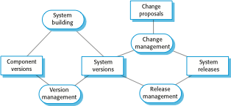
Configuration management activities

Slide 6
CM terminology
Term | Explanation
Configuration item or software configuration item (SCI) | Anything associated with a software project (design, code, test data, document, etc.) that has been placed under configuration control. There are often different versions of a configuration item. Configuration items have a unique name.
Configuration control | The process of ensuring that versions of systems and components are recorded and maintained so that changes are managed and all versions of components are identified and stored for the lifetime of the system.
Version | An instance of a configuration item that differs, in some way, from other instances of that item. Versions always have a unique identifier, which is often composed of the configuration item name plus a version number.
Baseline | A baseline is a collection of component versions that make up a system. Baselines are controlled, which means that the versions of the components making up the system cannot be changed. This means that it should always be possible to recreate a baseline from its constituent components.
Codeline | A codeline is a set of versions of a software component and other configuration items on which that component depends.

Slide 7
CM terminology
Term | Explanation
Mainline | A sequence of baselines representing different versions of a system.
Release | A version of a system that has been released to customers (or other users in an organization) for use.
Workspace | A private work area where software can be modified without affecting other developers who may be using or modifying that software.
Branching | The creation of a new codeline from a version in an existing codeline. The new codeline and the existing codeline may then develop independently.
Merging | The creation of a new version of a software component by merging separate versions in different codelines. These codelines may have been created by a previous branch of one of the codelines involved.
System building | The creation of an executable system version by compiling and linking the appropriate versions of the components and libraries making up the system.

Slide 8
Change management
Organizational needs and requirements change during the lifetime of a system, bugs have to be repaired and systems have to adapt to changes in their environment.
Change management is intended to ensure that system evolution is a managed process and that priority is given to the most urgent and cost-effective changes.
The change management process is concerned with analyzing the costs and benefits of proposed changes, approving those changes that are worthwhile and tracking which components in the system have been changed.

Slide 9
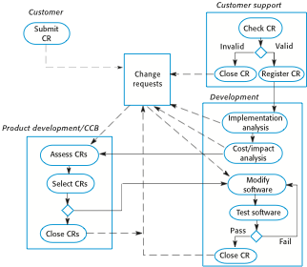
The change management process

Slide 10
A partially completed change request form (a)
Change Request Form
Project: SICSA/AppProcessingNumber: 23/02
Change requester: I. SommervilleDate: 20/01/09
Requested change: The status of applicants (rejected, accepted, etc.) should be shown visually in the displayed list of applicants.
Change analyzer: R. LooekAnalysis date: 25/01/09
Components affected: ApplicantListDisplay, StatusUpdater
Associated components: StudentDatabase

Slide 11
A partially completed change request form (b)
Change Request Form
Change assessment: Relatively simple to implement by changing the display color according to status. A table must be added to relate status to colors. No changes to associated components are required.
Change priority: Medium
Change implementation:
Estimated effort: 2 hours
Date to SGA app. team: 28/01/09 CCB decision date: 30/01/09
Decision: Accept change. Change to be implemented in Release 1.2
Change implementor: Date of change:
Date submitted to QA: QA decision:
Date submitted to CM:
Comments:

Slide 12
Factors in change analysis
The consequences of not making the change
The benefits of the change
The number of users affected by the change
The costs of making the change
The product release cycle

Slide 13
Change management and agile methods
In some agile methods, customers are directly involved in change management.
The propose a change to the requirements and work with the team to assess its impact and decide whether the change should take priority over the features planned for the next increment of the system.
Changes to improve the software improvement are decided by the programmers working on the system.
Refactoring, where the software is continually improved, is not seen as an overhead but as a necessary part of the development process.

Slide 14
Derivation history
// SICSA project (XEP 6087)
//
// APP-SYSTEM/AUTH/RBAC/USER_ROLE
//
// Object: currentRole
// Author: R. Looek
// Creation date: 13/11/2009
//
// © St Andrews University 2009
//
// Modification history
// Version Modifier Date Change Reason
// 1.0 J. Jones 11/11/2009 Add header Submitted to CM
// 1.1 R. Looek 13/11/2009 New field Change req. R07/02

Slide 15
Version management
Version management (VM) is the process of keeping track of different versions of software components or configuration items and the systems in which these components are used.
It also involves ensuring that changes made by different developers to these versions do not interfere with each other.
Therefore version management can be thought of as the process of managing codelines and baselines.

Slide 16
Codelines and baselines
A codeline is a sequence of versions of source code with later versions in the sequence derived from earlier versions.
Codelines normally apply to components of systems so that there are different versions of each component.
A baseline is a definition of a specific system.
The baseline therefore specifies the component versions that are included in the system plus a specification of the libraries used, configuration files, etc.

Slide 17
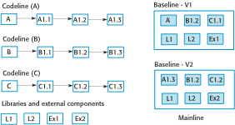
Codelines and baselines

Slide 18
Baselines
Baselines may be specified using a configuration language, which allows you to define what components are included in a version of a particular system.
Baselines are important because you often have to recreate a specific version of a complete system.
For example, a product line may be instantiated so that there are individual system versions for different customers. You may have to recreate the version delivered to a specific customer if, for example, that customer reports bugs in their system that have to be repaired.

Slide 19
Version management systems
Version and release identification
Managed versions are assigned identifiers when they are submitted to the system.
Storage management
To reduce the storage space required by multiple versions of components that differ only slightly, version management systems usually provide storage management facilities.
Change history recording
All of the changes made to the code of a system or component are recorded and listed.

Slide 20
Version management systems
Independent development
The version management system keeps track of components that have been checked out for editing and ensures that changes made to a component by different developers do not interfere.
Project support
A version management system may support the development of several projects, which share components.

Slide 21
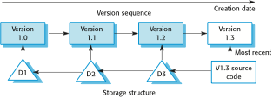
Storage management using deltas

Slide 22
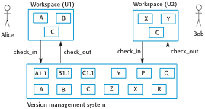
Check-in and check-out from a version repository

Slide 23
Codeline branches
Rather than a linear sequence of versions that reflect changes to the component over time, there may be several independent sequences.
This is normal in system development, where different developers work independently on different versions of the source code and so change it in different ways.
At some stage, it may be necessary to merge codeline branches to create a new version of a component that includes all changes that have been made.
If the changes made involve different parts of the code, the component versions may be merged automatically by combining the deltas that apply to the code.

Slide 24
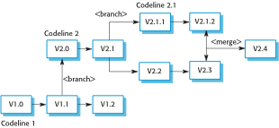
Branching and merging

Slide 25
Key points
Configuration management is the management of an evolving software system. When maintaining a system, a CM team is put in place to ensure that changes are incorporated into the system in a controlled way and that records are maintained with details of the changes that have been implemented.
The main configuration management processes are change management, version management, system building and release management.
Change management involves assessing proposals for changes from system customers and other stakeholders and deciding if it is cost-effective to implement these in a new version of a system.
Version management involves keeping track of the different versions of software components as changes are made to them.

